Slide 1
integration & UI testing
Effective and efficient quality assurance

Slide 2
Overview
What is it (integration testing)
Who does it
Why do we need it
How do we do it
When do we do it
Where do we do it

Slide 3
What is integration testing?
INTEGRATION TESTING is a level of software testing where individual units are combined and tested as a group. The purpose of this level of testing is to expose faults in the interaction between integrated units.

Slide 4
Difference between unit tests and integration tests
Unit tests | Integration tests
Scope = Narrow | Scope = Wide
Checks if small piece of code is doing what it is suppose to do. | Checks if different pieces of the modules are working together.
No dependencies on code outside the unit tested. | Dependent on other outside systems like databases, hardware allocated for them etc.
Created and executed by developer | Created and executed by testing team

Slide 5
Why do we do QA?
QA gives customers a great experience using software that we create.
QA helps the business save money
QA also gives developers the confidence to break things and try different risky approaches without worrying about old code.

Slide 6
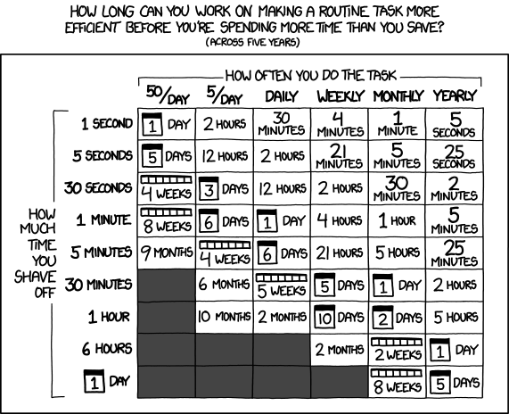
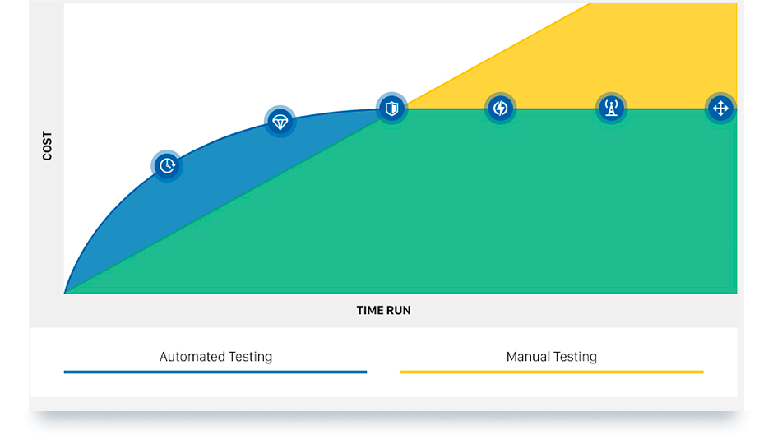
Automated QA vs manual QA

Slide 7
Who does it?
Stock photo of Automation QA professional 404 error
Testing team comprised of software engineers
An automated qa engineer typically:
Uses various testing frameworks and scripting languages
Peer reviews
Maintains test code base
Researches new technologies

Slide 8
How do we do integration testing
Step 1. Create new test that tells you something when it fails
Step 2. Run all tests written in the past

Slide 9
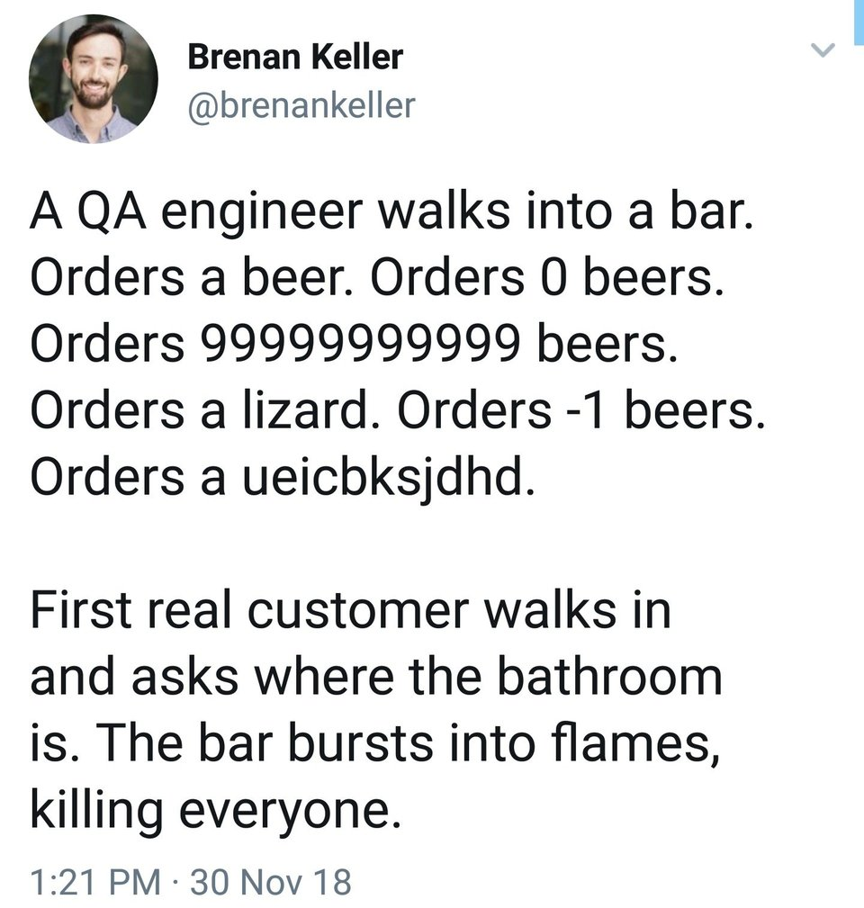
Good test vs bad test
Good:
Testing functionality
fail as expected
Eg. divide by zero
pass as expected
Eg. 1+1=2
Bad:
Testing something that’s been tested before
Something that is better tested manually eg. Appearance of application

Slide 10
UI test steps
Grab objects (depends on testing tools)
Manipulate objects (Scripting language))
Check outcomes (Magic Logic)

Slide 11
Test creation priorities
Close to full coverage
Reduce test run time
Readability is key

Slide 12
When do we do it?
Plan test scope during sprint planning and development planning
Plan, design & develop test while developers write code
Regression happens after every feature is ready to be merged into main branch

Slide 13
Where do we do it?
Write tests on your machine
Tests run on a different machine. Either VM or physical machine

